Slide 1

PRESENTED BY- Anjali Saxena

Slide 2
PROBLEM STATEMENT
Menstruation or periods are the normal and healthy part of life of women. But, lack of availability of sanitary products and hygienic infrastructure exacerbate the problem for women during their menstrual cycle leaving them in helpless and isolated state. Also, entrenched stigma and taboos related to menstruation worsen the situation for women. Hence, drastic changes are needed to encourage positive social norms and ultimately enact behavioural change towards menstruation process.

Slide 3
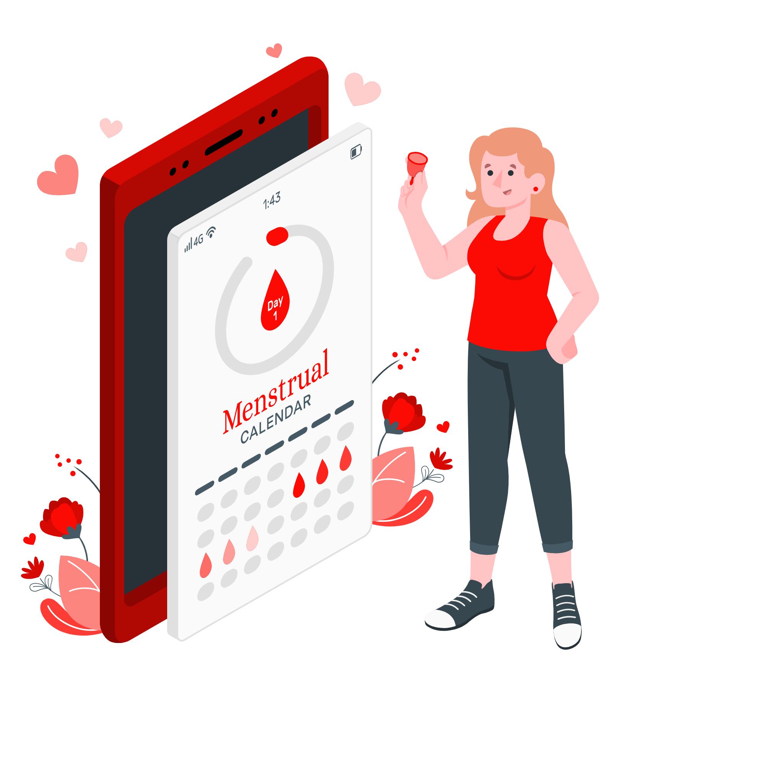
MISSION RED
Mission Red is a web portal that aims to create awareness about menstruation and provide solutions to the general problems faced by women during this phase. It provides doctor's consultation support, delivery service by stores selling sanitary products, periods tracker and blog writing section to publicly discuss about menstruation.

Slide 4
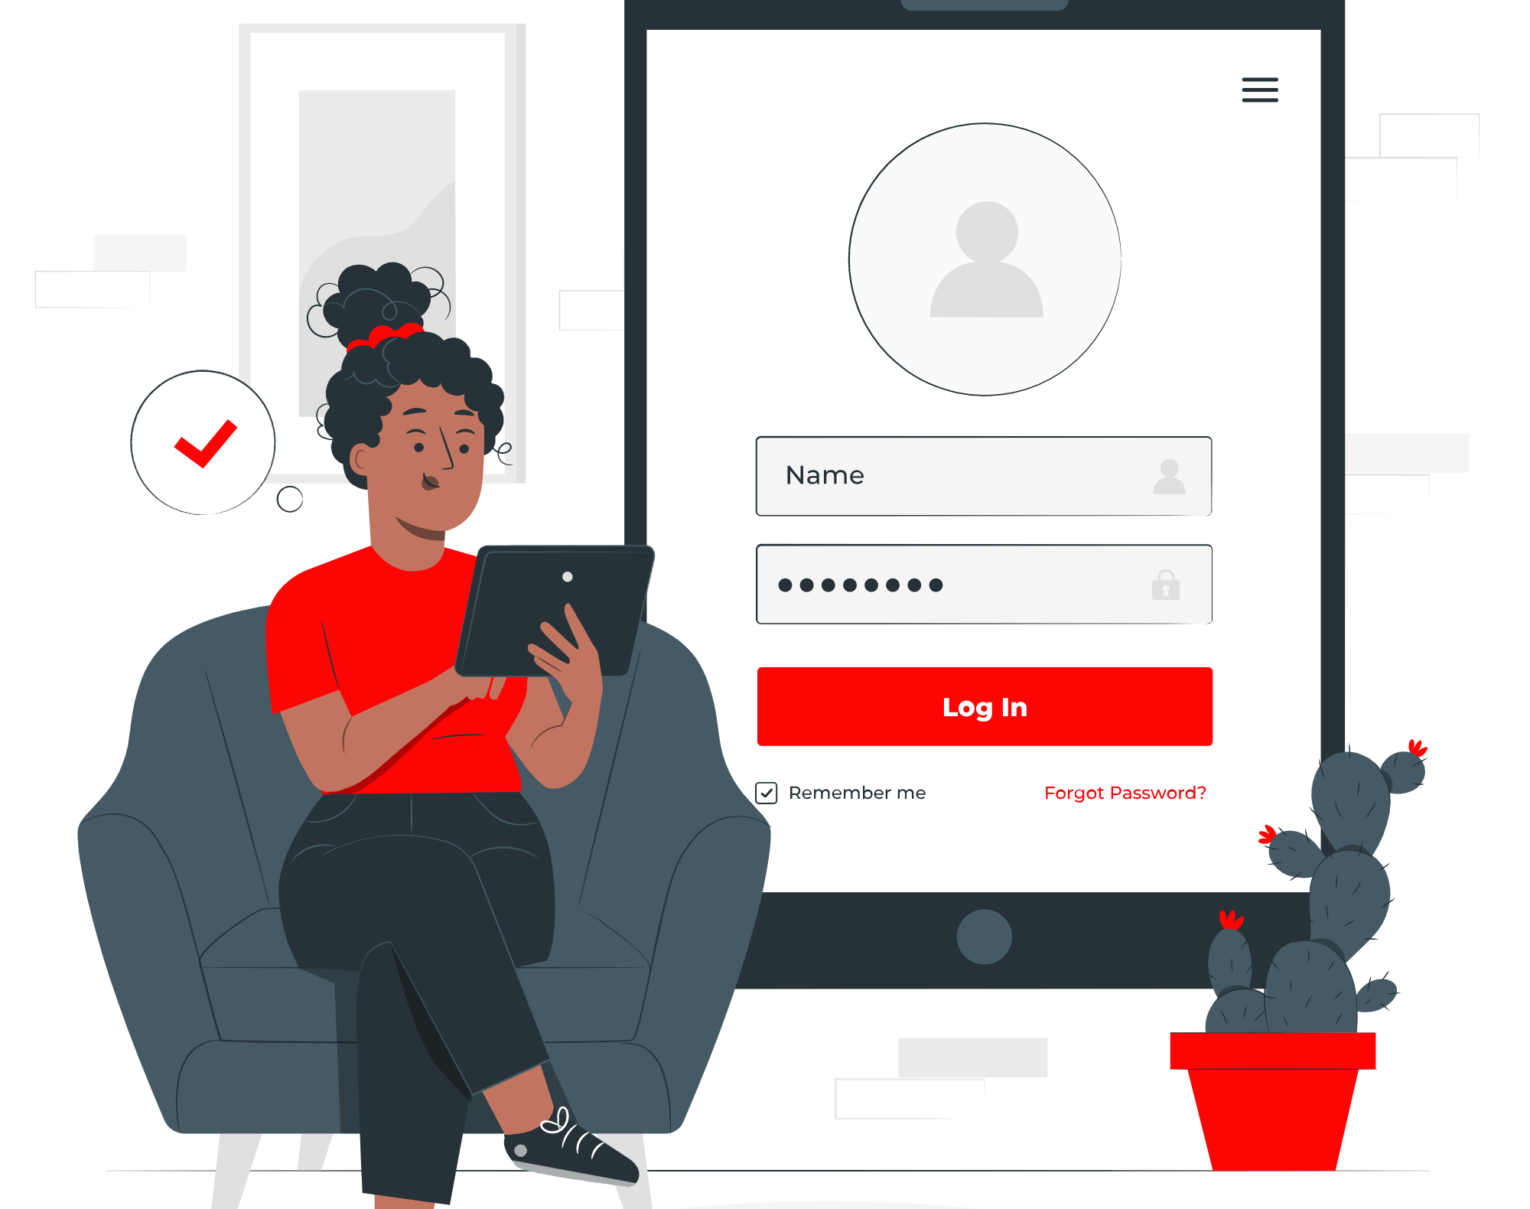
USERS
Doctors
Pharmacists
General Users

Slide 5

DOCTOR CONSULTATION
General practitioner, gynecologist or any other doctors can register on this project and contribute their bit in this mission by educating people about this natural process and provide consultation and solution to the problems faced by women during periods such as hormonal changes, weakness, etc.

Slide 6

SANITARY PRODUCTS DELIVERY
Pharmacist or store owners having sanitary products can register on this project and can contribute their bit in this mission by delivering the essential sanitary products to the current location of the user be it home, office or any other place.

Slide 7

BLOG WRITING SECTION
Users can create awareness about menstruation by sharing their views on the topic on public platform. They can write blogs, stories or any other experience that they can create an impact on the society. Also, they can read the stories written by other users.

Slide 8
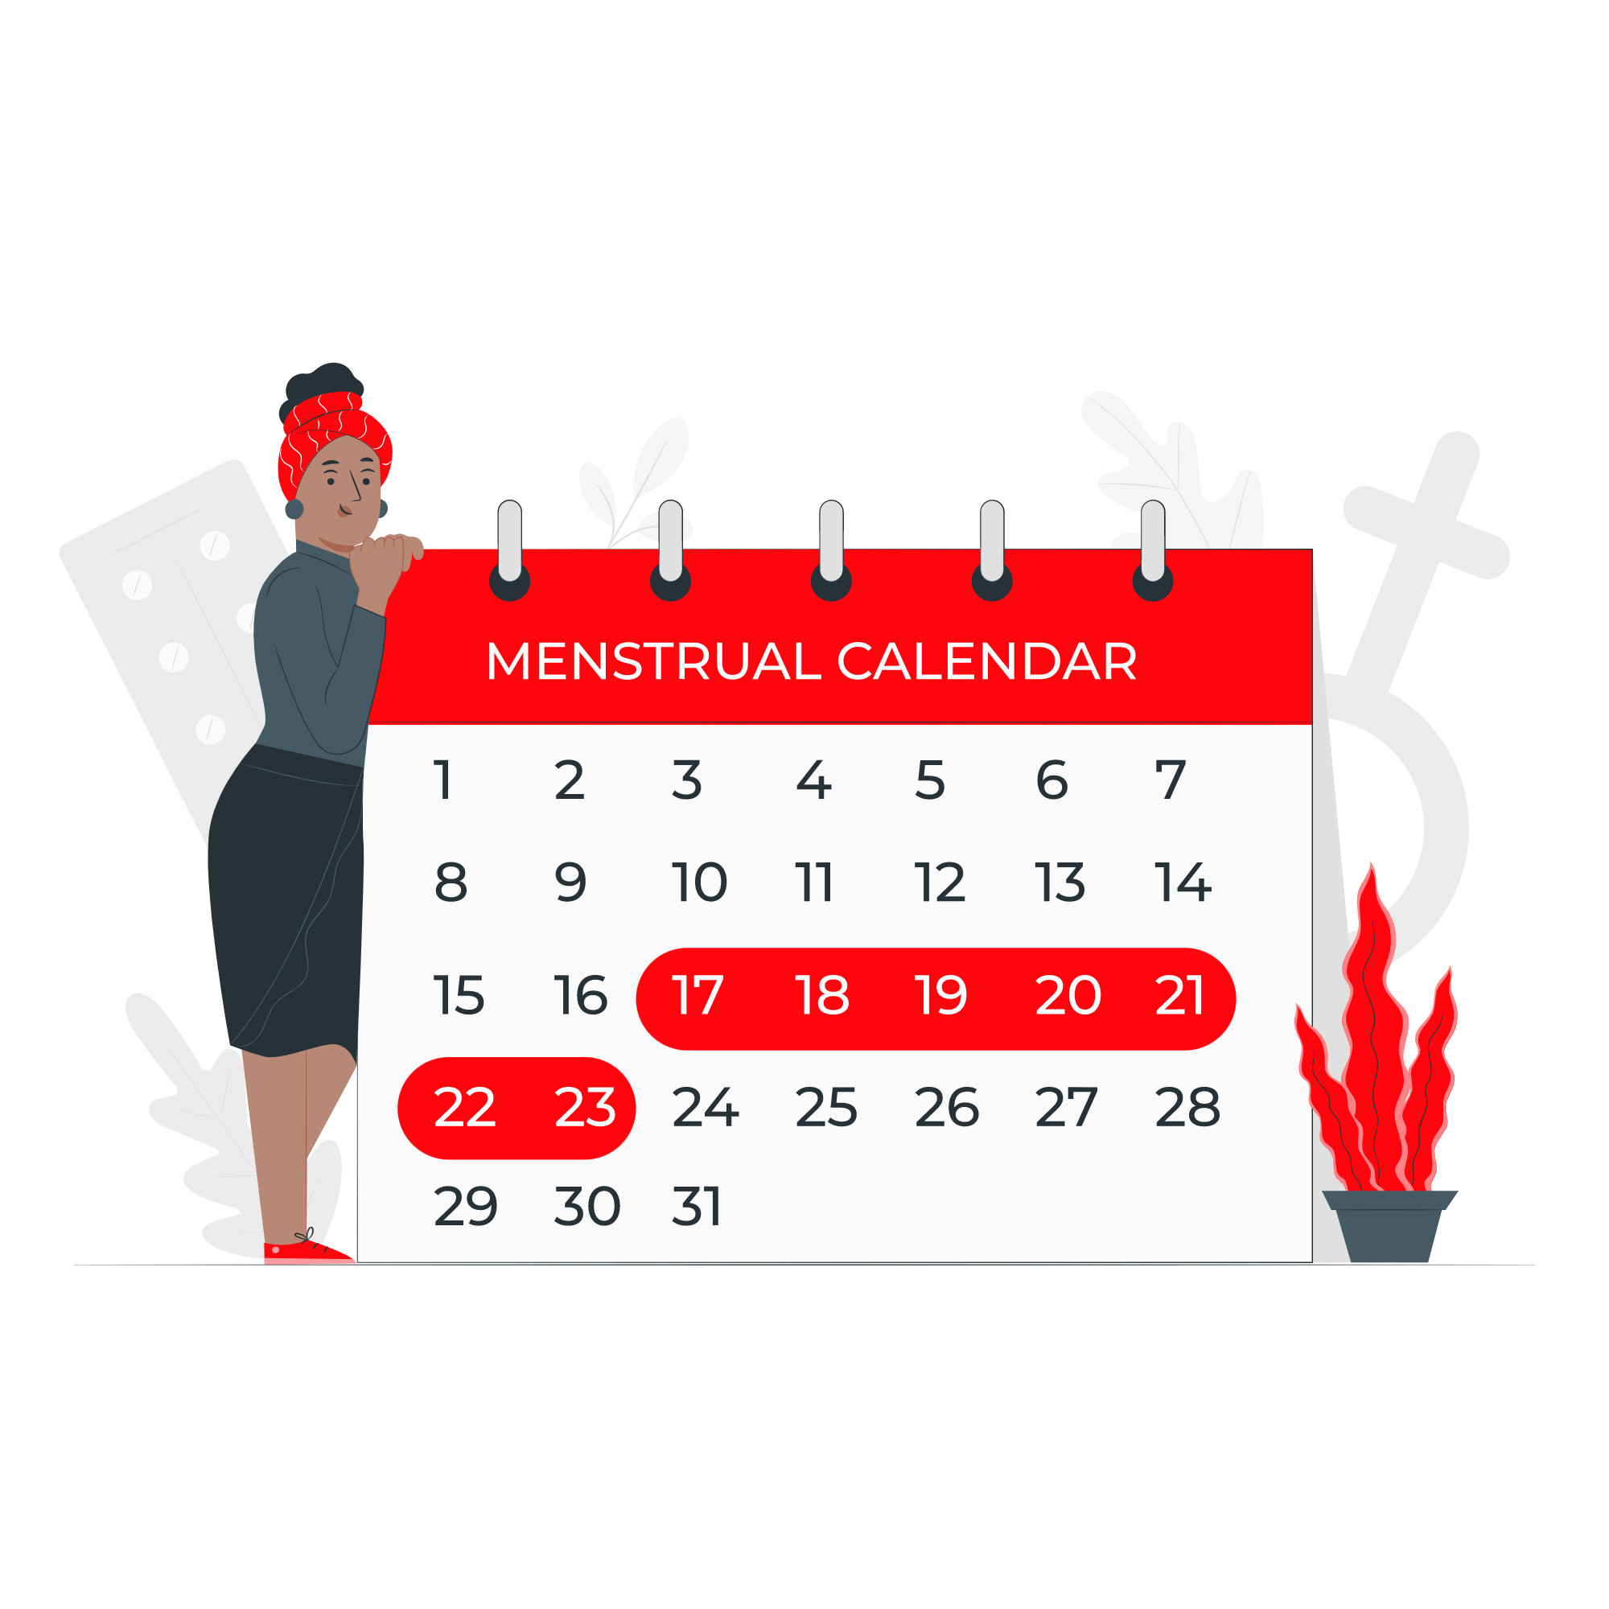
PERIOD SCHEDULE TRACKER
Women can track their menstrual cycle by storing the duration of their periods in this tracker. It will help them to identify whether they are having regular or irregular periods. They can also share these details while consulting a doctor for any period related problem and this will help the doctor to understand the situation better.

